Slide 1
MG Cars Resale Analysis – Cars24 Mumbai
- By Team L

Slide 2

Team Composition and Roles
Aditya Sharma - Lead
Aryan Singh
- Co-Lead
Arshiya Firdous
- Member
Ojaswi B
- Member
Sahil Patil
- Member
Shubham Vijay - Member
Ritesh Kumar
- Member
Abhilash A
- Member
Maisha Khatun
- Member
Dinesh Kumar
- Member

Slide 3





Methodology: Workflow and Implementation Steps
1
Objective
Web Scraping
Data Cleaning
EDA
Insights
Analyze used MG cars listings in Mumbai to find trends and insights
Collected data from Cars24.com using Python & BeautifulSoup
Removed junk values, fixed formats & prepared data
for analysis
Explored trends using graphs to understand pattersn in the data
Found top models, price trends, and fuel preferences

Slide 4
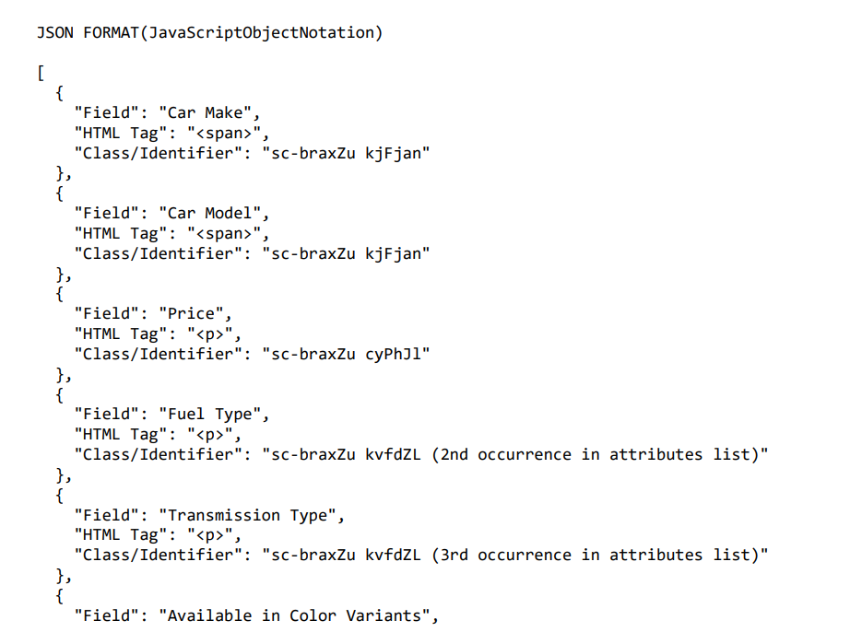
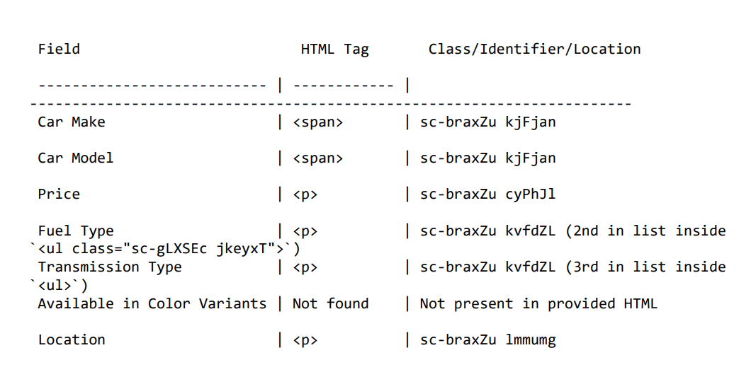
Data Acquisition and Source Structure
HTML Tags in JSON
HTML Tags

Slide 5
Project Introduction and Objective
This project focuses on analyzing the resale market for MG cars in Mumbai using data scraped from the Cars24 website. As MG is a rising brand in India’s automotive scene, studying its used car listings helps us understand how different factors affect resale value. We collected key details like the car’s year, kilometers driven, fuel type, transmission, ownership history, and price. The goal was to explore how these features influence pricing and availability in a specific metro city. This kind of analysis is valuable for buyers, sellers, and dealers who want insights into pricing trends and consumer preferences. We used web scraping to extract real-time data, and then applied basic data cleaning and visualization to interpret it. Despite the small dataset, we identified meaningful patterns in car pricing based on features and location. Overall, this project gave us hands-on experience in working with real-world data from end to end.

Slide 6

What is Web Scraping and Why It Matters
Introduction
Web scraping is a method used to automatically collect data from websites. It helps extract useful information like text, prices, or listings directly from the site's HTML code. In our project, we used web scraping to gather MG car listings from Cars24.com.
Applications
Price tracking
Market research
Data collection
Product monitoring
Lead generation
New aggregation
Job listings
Trend analysis
Review mining
Stock monitoring
Competitor analysis
Event tracking
Tools
BeautifulSoup : Parsed the HTML and extracted car details like model, price, etc.
Requests : Fetched the HTML content of the Cars24 webpage.
Python : Main programming language used to write the scraping script.

Slide 7
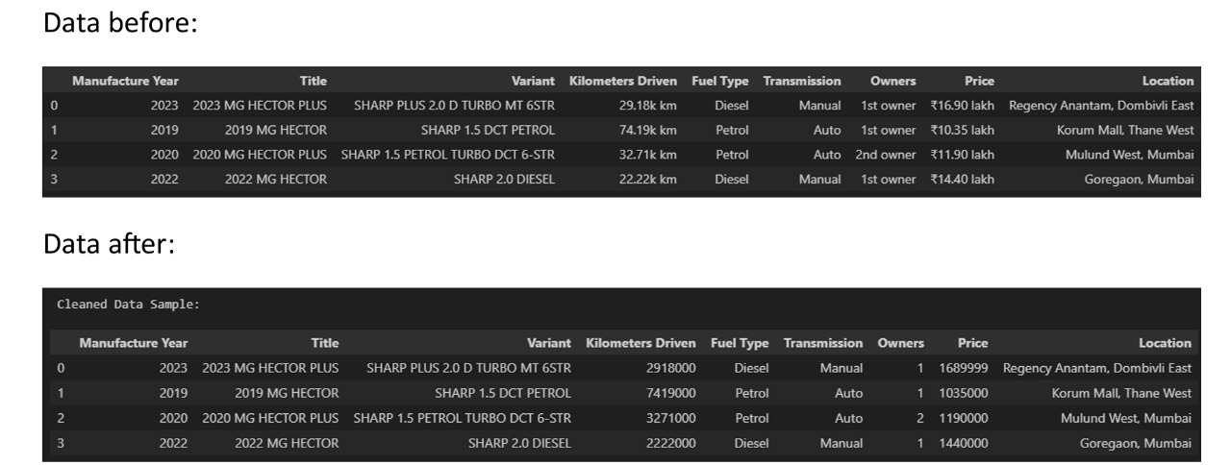
Data Cleaning and Preprocessing
Data Before
Data After

Slide 8
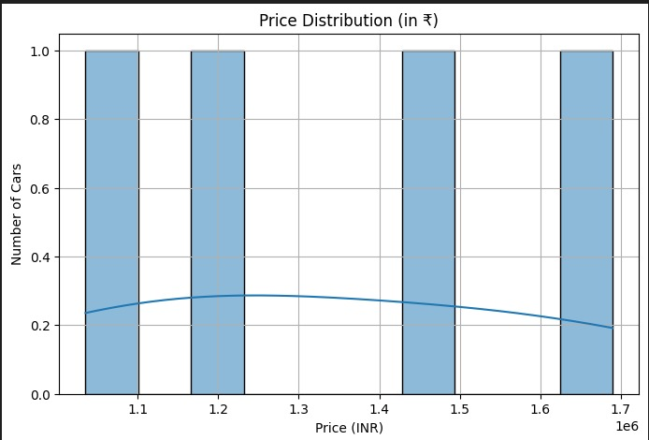
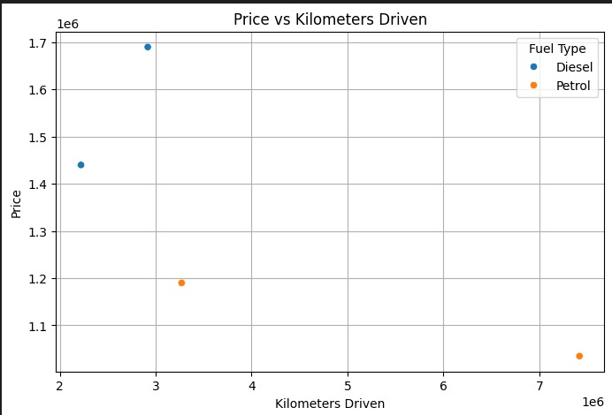
Exploratory Data Analysis
Before arriving at the insights, we explored the dataset to understand the structure, detect patterns, and assess the relevance of different features
This exploration helped us narrow down which factors were most meaningful.

Slide 9
Analytical Findings and Key Observations
Production Year
Fuel type
Kms driven
Transmission Type
Number of owners
Location
New cars have higher prices. Older cars can show more price variation depending upon usage & condition | Diesel variants generally have a slightly higher median price compared to petrol, likely due to better milage and re-sale value | Higher usage correlates with lower prices. Diesel cars retain value better than petrol counterparts | Automatic transmission cars tend to cost more than the manual ones. Reflecting buyer preferences for convenience | Cars with more than one previous owner are priced lower, indicating depricating with ownership history | Urban areas like Mulund, Goregaon & Thane list higher-priced cars.
Price
High
Medium
Low

Slide 10
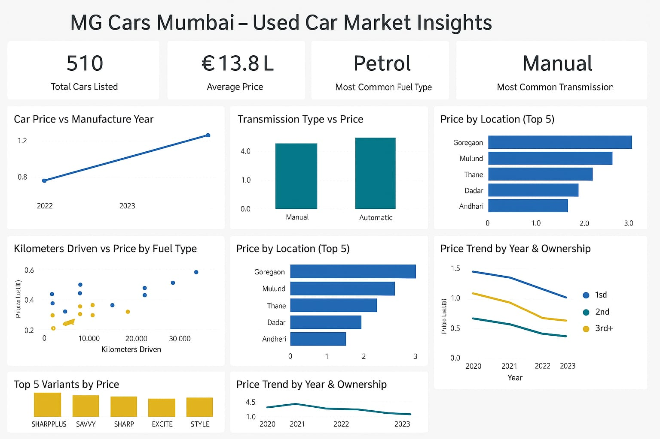
Data Transformation and Tabular Representation

Slide 11
Technical and Operational Challenges Encountered
Understanding Workflows
As first-timers, the scraping process took more time than planned to grasp and implement.
Power BI Dashboard
Choosing charts that were both clear and insightful, without overcrowding, was a key challenge.
Identifying the correct HTML tags for each data point required repeated inspection and testing, due to the complexity of the site’s structure.
Right HTML Tags
Small Dataset
Only 4 MG car listings were available for Mumbai, which restricted the depth of our analysis & limited broader trend detection.

Slide 12
Project Learnings and Skill Development
Data Exploration
Gained learning experience of how to explore, clean, & analyze the scraped data efficiently
Web Scraping
Practiced extracting data from real websites usings Requests and Beautiful Soup
Data Visualisation
Achieved to overcome the key challenge of selecting clean & insightful charts without overcrowding
Understood how to inspect HTML to find & collect relevant data and used browser inspect tools to find the HTML tags
HTML Structure
Teamwork
Experienced collaboration in dividing tasks, solving issues & merging insights.

